Slide 1
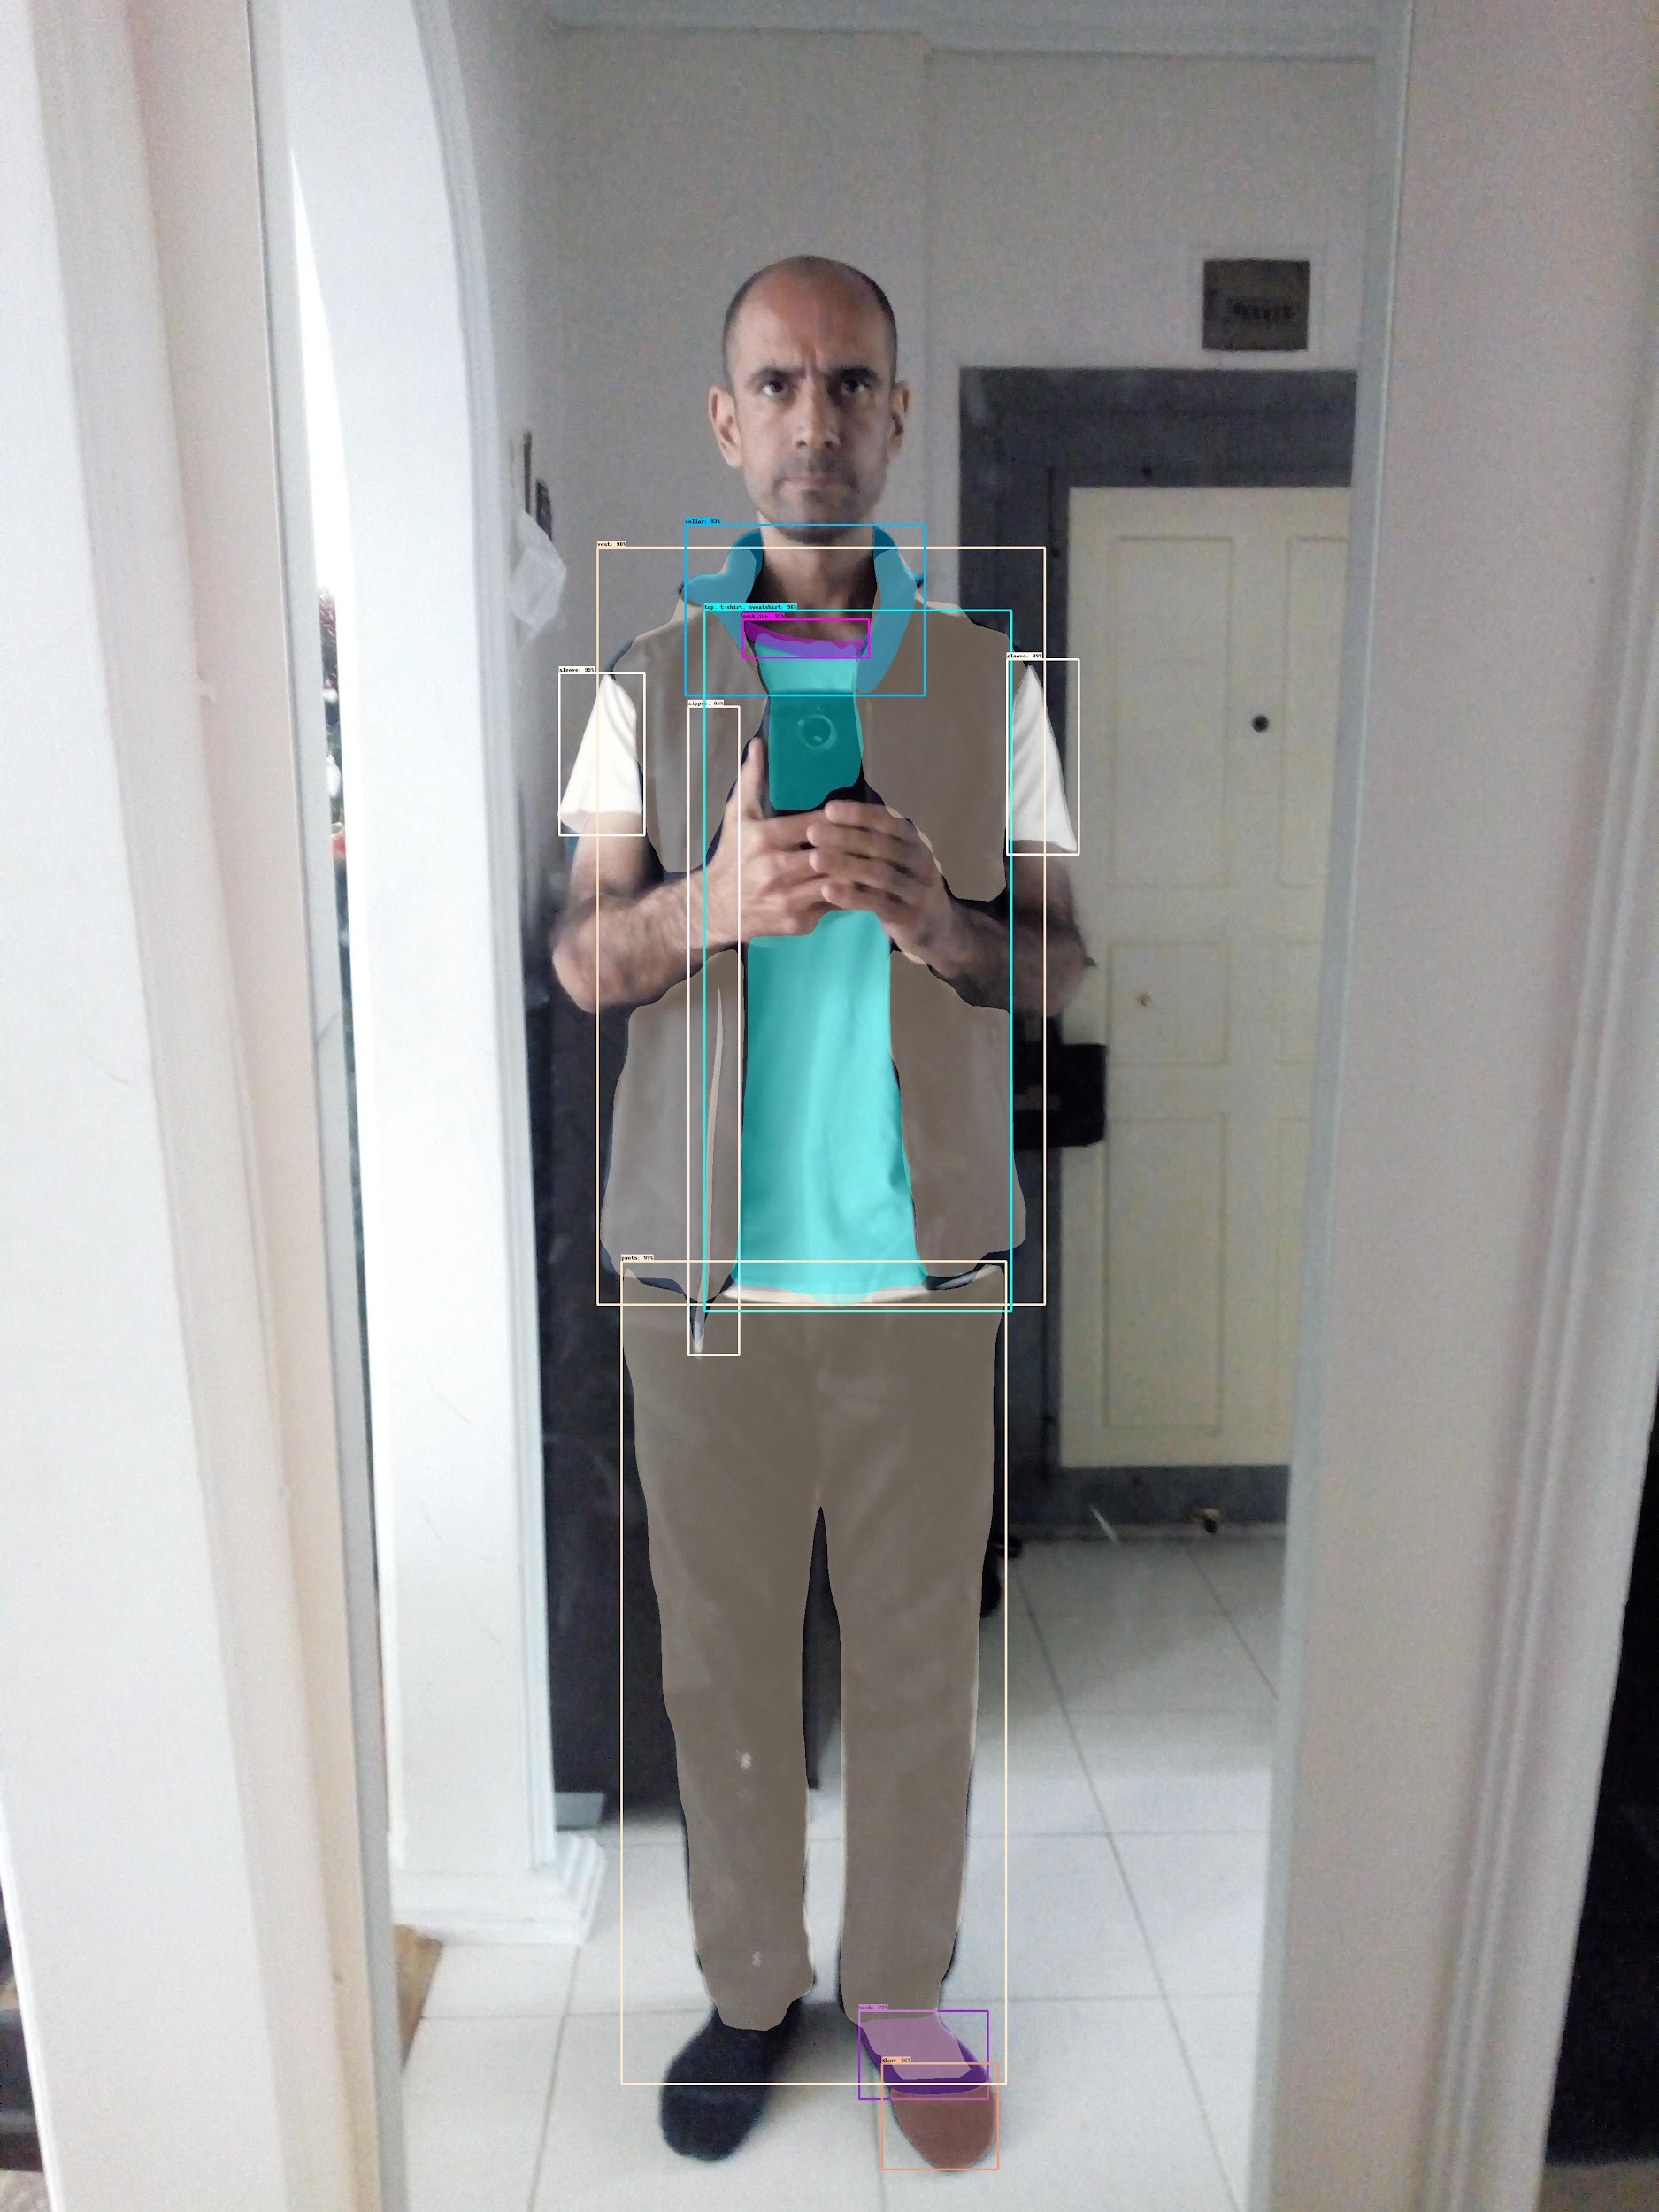
dress me up! CMP 784 – PROJECT FINAL PRESENTATION
Presenters:
Tahir Büyükbaşaran
Yusuf Çağrı Öğüt
“This vest would go better with a blue shirt!”

Slide 2
OVERVIEW OF THE PROJECT

Slide 3
PROBLEM STATEMENT AND MOTIVATION
PROBLEM STATEMENT:
“Creating textual descriptions, comments and suggestions on combinations based on segmented clothing images.”
MOTIVATION:
To create an (objective) outfit combination evaluation model
Adding objectivity by building the evaluation based on choice of population
Building a combination suggestion model, on top of them.

Slide 4
RELATED WORKS

Slide 5
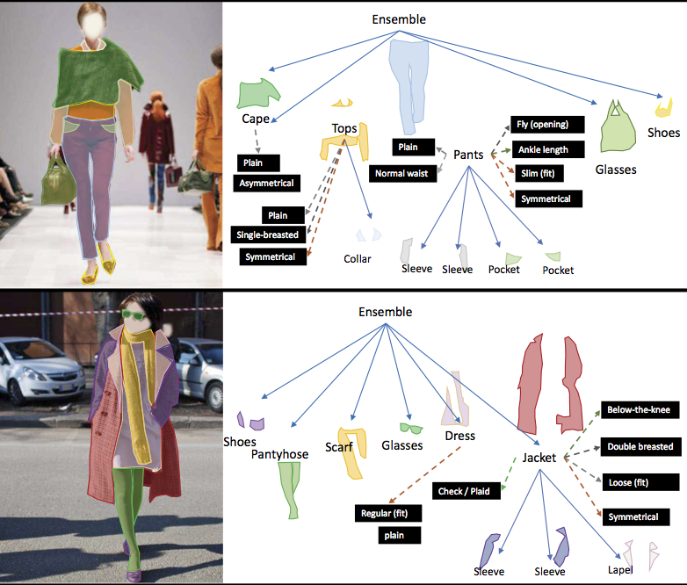
RELATED WORKS - FASHIONPEDIA
Has Python API
Last update at 2020 (tricky run)
SpineNet143 (ResNet50, ResNet101, SpineNet49 was also available) is run with checkpoint and output obtained
TO-DO: Semantic output creation
“Green dress with purple pants…”
Consists of two parts:
(1) An ontology built by fashion experts containing 27 main apparel categories, 19 apparel parts, 294 fine-grained attributes and their relationships
(2) A dataset with 48k everyday and celebrity event fashion images annotated with segmentation masks and their associated per-mask fine-grained attributes, built upon the Fashionpedia ontology.
https://fashionpedia.github.io/home/

Slide 6
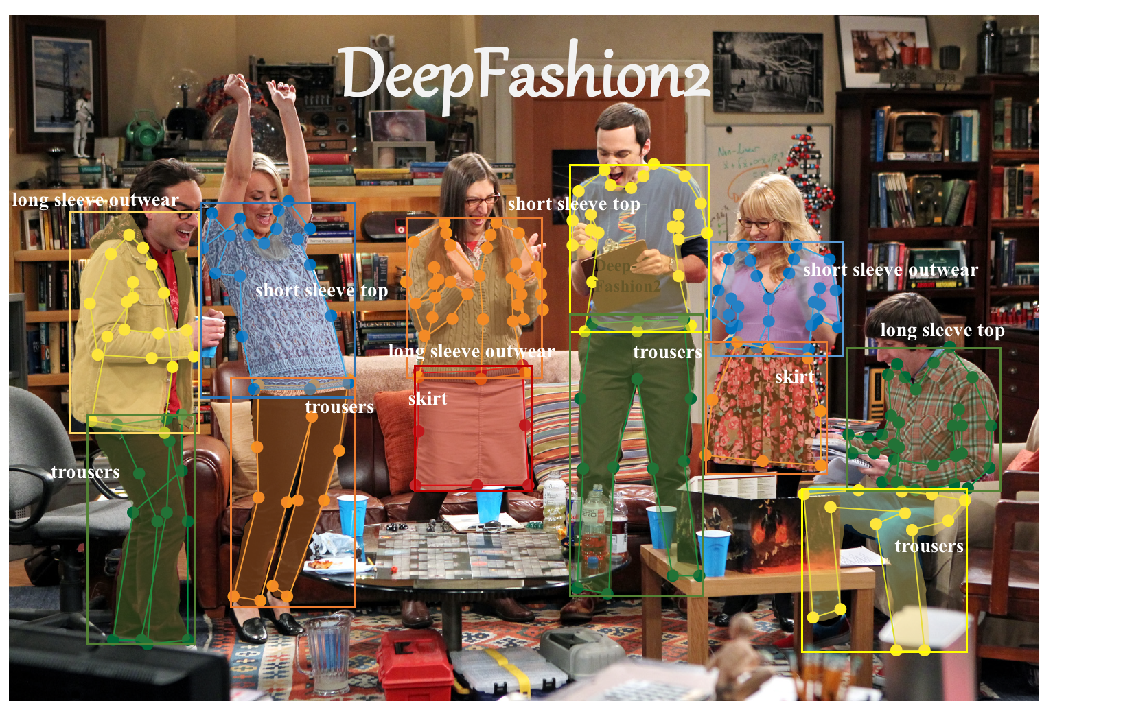
RELATED WORKS – DEEPFASHION2
491K diverse images of 13 popular clothing categories
Totally has 801K clothing items, where each item in an image is labeled with scale, occlusion, zoom-in, viewpoint, category, style, bounding box, dense landmarks and per-pixel mask.
Also 873K Commercial-Consumer clothes pairs.
https://github.com/switchablenorms/DeepFashion2

Slide 7
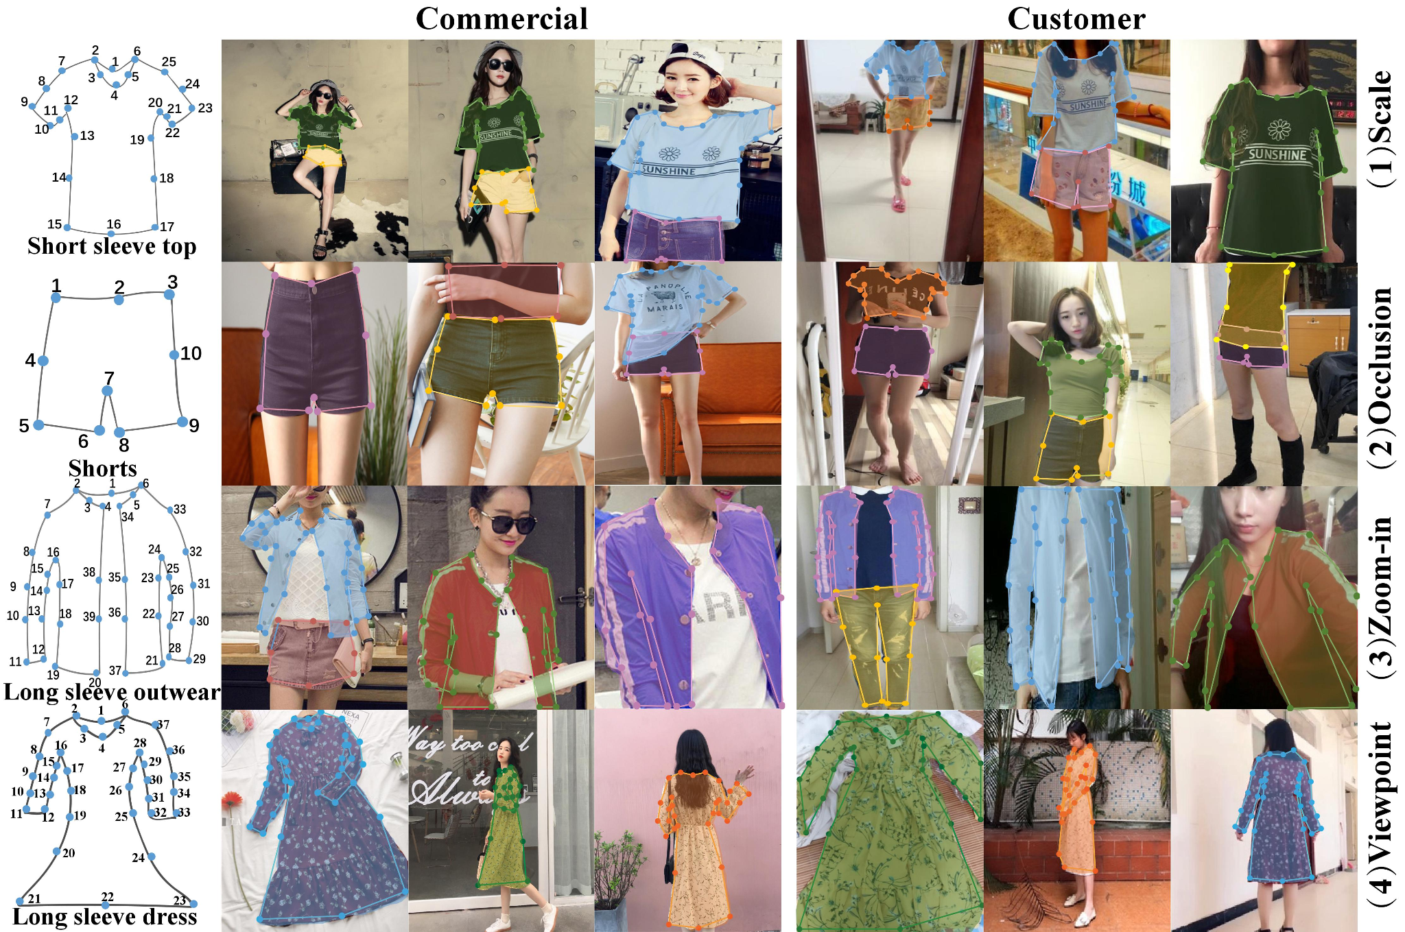
RELATED WORKS – DEEPFASHION2
The dataset is open for education use
Meta AI’s library
We trained Detectron2 with DeepFashion2 validation set
Includes Mask-RCNN models
https://github.com/switchablenorms/DeepFashion2

Slide 8
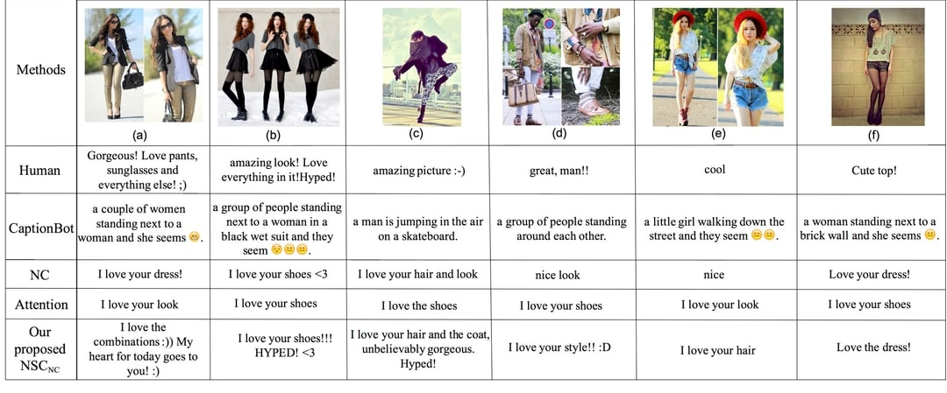
RELATED WORKS - NETILOOK
Paper “Netizen-Style Commenting on Fashion Photos: Dataset and Diversity Measures”
The dataset is open for educational purpose.
Generating netizen style comments on clothing combinations
Contains 355,205 images from 11,034 users and 5 million associated comments collected from Lookbook
https://www.v7labs.com/open-datasets/netilook
https://arxiv.org/pdf/1801.10300.pdf

Slide 9
KEY TECHNICAL IDEAS
IMAGE CAPTIONING
SUGGESTION MODEL
SUGGESTION SENTENCE CREATION

Slide 10
KEY TECHNICAL IDEAS IMAGE CAPTIOINING

Slide 11
KEY TECHNICAL IDEAS SUGGESTION MODEL

Slide 12
KEY TECHNICAL IDEAS SUGGESTION SENTENCE CREATION

Slide 13
STRENGTHS AND WEAKNESSES

Slide 14
THANK YOU FOR YOUR TIME!

